Slide 1

Model Checking Using SPIN/PROMELA

Slide 2
Formal Verification : Background
The process of Formal Verification consists of
Requirements Capture Modeling Specification
Analysis Documentation
In practice, some phases may overlap
The overall process is iterative rather than sequential

Slide 3
Model Checking
Model checking
Is one of the powerful FORMAL VERIFICATION technique
Allows one to verify temporal properties of a finite state representation
The finite state representation is that of a typical concurrent system
The representation is a model of the system
The basic idea is
That a finite state model of a system is systematically explored in order to determine whether or not a given temporal property holds
Deliver a counter-example if the specified property does not hold.

Slide 4
Model Checking
State space explosion
Because a complete state space is generated for a given model, the analysis may fail due to lack of memory, if the model is too large.
Can be tackled via abstraction
Verifying design model
Against specification for finite state concurrent systems
It is an automated technique wherein
Inputs
Finite state model of the system and properties stated in some standard formalism
Outputs
Property valid against the model or not

Slide 5
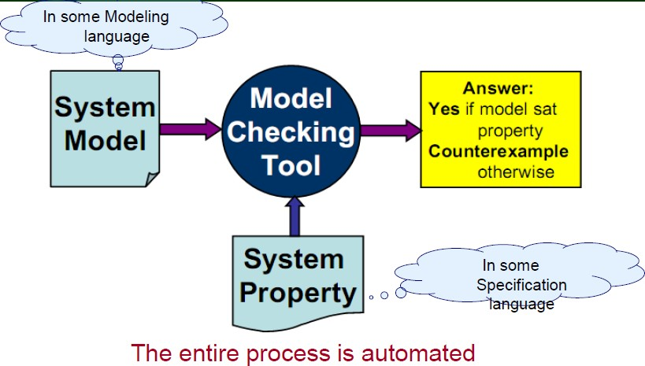
Model Checking

Slide 6
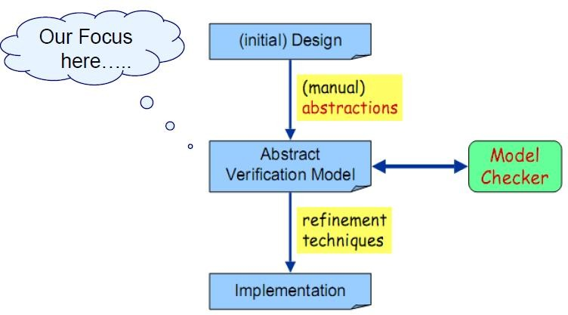
Model Checking

Slide 7
Applicability: Distributed Systems
Specific concern on the distributed systems
Network Applications
Data Communication Protocols Multithreaded code
Client-Server applications
Suffer from common design flaws

Slide 8
Common Design Flaws..
Deadlock
Livelock, Starvation Underspecification
Unexpected reception of messages
Overspecification
Dead code
Violations of constraints
Buffer overruns
Array bound violations

Slide 9

Model Checking Definition
“Model checking is an automated technique that,
Given a finite-state model of a system and
A logical property, systematically checks whether this property holds for (a given initial state in) that model”
Does system model M with initial state s satisfy system property p
M given as a state machine, that is finite-state
p is usually specified in temporal logic

Slide 10
Model Checking with SPIN
Involves three steps Modeling
Convert the design into a formalism to be accepted by the model checking tool SPIN
Specification
State the properties that the design must satisfy Must be complete
Verification
Normally based on a tool i.e. on SPIN Is automatic
Analysis of verification results is, however, manual
29-Sep-17

Slide 11
Introduction to SPIN
SPIN – Simple Promela INterpreter
A tool for analyzing the logical consistency of concurrent systems, specifically of data communication protocols
System model of a concurrent system is described in PROMELA
PROMELA – PRocess MEta Language
Specification language to model finite-state systems & allows dynamic creation of concurrent processes
Expressive enough to describe processes and their interactions in Synchronous as well as Asynchronous manner
Resembles the programming language C

Slide 12
Introduction to SPIN
PROMELA and SPIN/XSPIN are
Developed by Gerard Holzmann at Bell Labs Freeware for non-commercial use
Is a State-of-art model checker

Slide 13
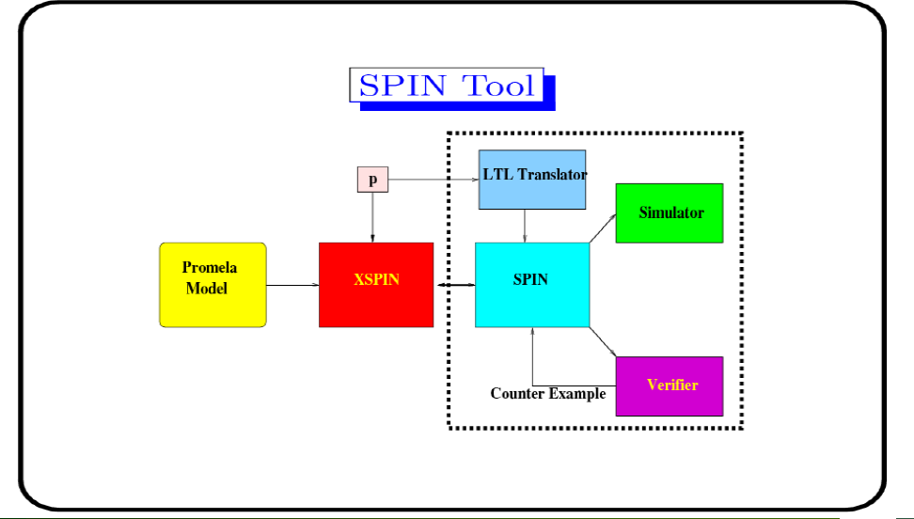
Introduction to SPIN
The SPIN tol

Slide 14
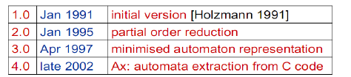
Introduction to SPIN SPIN…
Major versions:
Some success factors of SPIN
“Press on the button” verification (model checker) Very efficient implementation (using C)
Nice Graphical user interface (Xspin)
Not just a research tool, but well supported
Contains more than two decades research on advanced computer aided verification (Many optimization alogorithms)

Slide 15
Introduction to SPIN…
SPIN’s starting page: http://www.spinroot.com Basic SPIN manual Getting started with Xspin Getting started with SPIN Examples and Exercises
Concise Promela Reference Proceedings of all SPIN workshops
Gerard Holzmann’s website for papers on SPIN
http://cm.bell-labs.com/cm/cs/who/gerard/

Slide 16
PROMELA
Defining a validation model consisting of
A set of states incorporating info about values of variables, program counters etc.
A transition relation
A representation of a FSM in terms of
Processes Message Channels State Variables
Only the design of consistent set of rules to govern interaction amongst processes in a Distributed System NOT the implementation details

Slide 17
PROMELA
PROMELA model consists of
Process declarations Channel declarations Variable declarations Type declarations INIT process
As mentioned, PROMELA model = FSM (Usually a very large)
But it is finite and hence has
No unbounded data
No unbounded channels
No unbounded processes
No unbounded process creations

Slide 18
PROMELA Processes
A process type (proctype) consists of
A name, list of formal parameters, declarations of local variables and body
A process
Executes concurrently with all other processes Communicates with other processes using channels & global variables
May access shared variables Defined by proctype declarations
Each process has
Its program counter
Local variables (Local state)

Slide 19
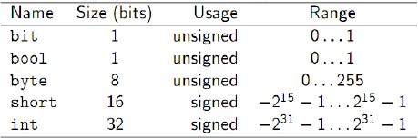
PROMELA Variables and Basic Data Types
PROMELA variables
Provide the means of storing information about the system being modelled
May hold global information on the system or information that is local to a particular component
Supports five basic data types

Slide 20
PROMELA Variables and Basic Data Types
PROMELA variables
Variables must be declared before they can be used
Variable declarations follow the style of the C programming language
A basic data type followed by one or more identifiers and optional initializer
– byte count, total = 0
By default all variables of the basic types are initialized to 0. As in C, 0 (zero) is interpreted as false while any non-zero value is interpreted as true

Slide 21
The init process
All PROMELA programs must contain an init process
Is similar to the main() function within a C program
The execution of a PROMELA program begins with the init process
An init process
Takes the form:
init {/* local declarations and statements */ }
init {skip}
While a proctype definition declares the behavior of a process, the instantiation and execution of a process definition is coordinated via the init process.

Slide 22
Statements
A process body consists of sequence of statements A statement is either
Executable: It can be executed immediately Blocked: It cannot be executed
An assignment statement is always executable
E.g. x = 2;

Slide 23

Statements
An expression is also a statement;
It is executable if it evaluates to non-zero
skip, 2 < 3 are always executable
X < 27 is executable only if the value of x is less than 27
A run statement is executable
Only if the process can be created
Returns 0 if this cannot be done
Value otherwise returned is a run-time process ID number
run() is defined as an operator and so can be embedded in other expressions.

Slide 24
Executability of Statements
Promela
Does not make a distinction between a condition and a statement
E.g. the simple boolean condition a == b represents a statement in Promela
Statements are either executable or blocked.
The execution of a statement is conditional or it being blocked.
Notion of statement executability provides the basic means by which process synchronization can be achieved.
E.g.
while (a != b) skip /*Conventional busy wait */
(a == b) /* Promela equivalent */

Slide 25
Hello World
A simple two process system proctype hello() { printf(“Hello”)} proctype world() {printf (“World \n”)} init { run hello(); run world(); }
init is the starting point
run operator is executable only if process instantiation is possible
If a run is executable than a pid is returned. The pid for a process can be accessed via the predefined local variable _pid.
The execution of run does not wait for the associated process to terminate. i.e. further applications of run will be executed concurrently

Slide 26
Process instantiation
A process can be instantiated also by using “active” in front of proctype definition.
i.e. HelloWorld can also be instantiated as active proctype hello() {printf(“Hello”)} active proctype world() {printf(“World\n”)}
Multiple instances of the same proctype declaration can be generated using an optional array suffix , e.g.
active [4] proctype hello() {printf(“Hello”)} active [7] proctype world() {printf(“World\n”)}

Slide 27
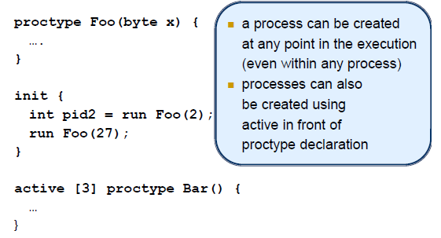
PROMELA: An illustration…

Slide 28
Other Data Types
Arrays
An array type is declared as int table[max]
This generates an array of integers i.e. table[0], table[1],…
Enumerated Types
A set of symbolic constants is declared as
mtype = {LINE_CLEAR, TRAIN_ON_LINE, LINE_BLOCKED}
A program can only contain one mtype declaration which must be global
Structures
A record data type is declared as
typedf msg {byte data[4], byte checksum}
Structure access is as in C
msg message;
… message.data[0]

Slide 29
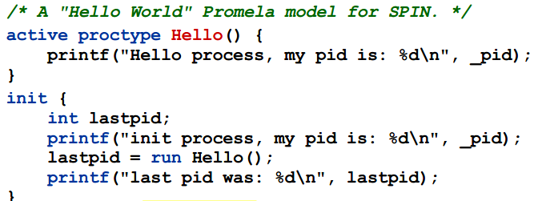
PROMELA – An illustration …
/* a Hello World PROMELA model for SPIN */
How many processes are created, here?

Slide 30
Statement Delimiters
Two types of statement delimiters
; and ->
Use the one that is most appropriate at the given situation Usually ; is used between ordinary statements
-> is often used after “guards” in a if OR do statement, pointing at what comes next
These can be used interchangeably.

Slide 31
Interleaving Semantics
PROMELA processes execute concurrently Non-deterministic scheduling of the processes Processes are interleaved
Statements of different processes do not occur at the same time
Exception: rendezvous communication
All statements are atomic;
each statement is executed without interleaving with other processes.
Each process may have several different possible actions enabled at each point of execution
Only one choice is made, non-deterministically i.e. randomly

Slide 32
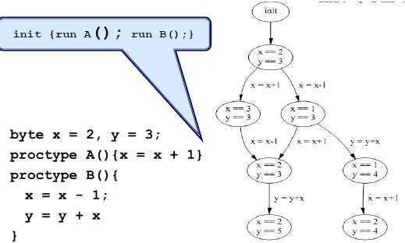
Interleaved Execution

Slide 33
Deterministic V/s Nondeterministic Behavior
Deterministic behaviour
A process is deterministic if for a given start state, it behaves in exactly the same way ; if supplied with the same stimuli from its environment.
Non-deterministic behaviour
A process is non-deterministic if it need not always behave in exactly the same way ; each time it executes from a given start state with the same stimuli from its environment
Hence, race conditions can occur..

Slide 34
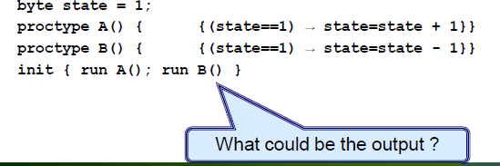
Race conditions
Solutions
Use standard mutex algorithms Use atomic sequences

Slide 35
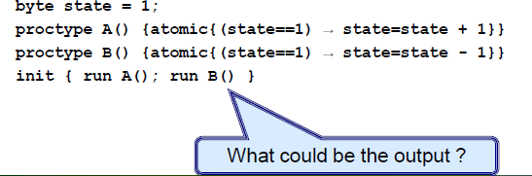
Race conditions
Solutions
Use standard mutex algorithms Use atomic sequences

Slide 36
Using atomic
atomic keyword
Helps avoid the undesirable interleaving of the PROMELA execution sequences…
Restricts the level of interleaving and so
Reduces complexity when it comes to validating a PROMELA model.
However, atomic should be used carefully…

Slide 37
PROMELA Control Structures
Three ways for achieving control flows
Statement sequencing Atomic sequencing Concurrent process execution
PROMELA supports three additional control flow constructs
Case selection Repetition Unconditional Jumps

Slide 38
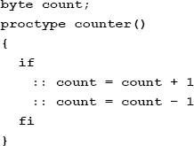
Case Selection
Chooses one of the executable choices.
If no choice is executable, the if-statement is blocked.
The executability of the first statement (guard) in each sequence determines whether sequence is executed OR not

Slide 39
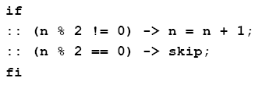
Case Selection
An example of case selection with guards
If there is at least one choice (guard) executable,
The if statement is executable and SPIN non-deterministically choose one of the alternatives.
The operator -> is equivalent to ;
By convention, it is used within if-statements to separate the guards from the statements that follow the guards.

Slide 40

Case Selection
Guards need not be mutually exclusive
If x and y are equal then
The selection of which statement sequence is executed is decided at random, giving rise to non-deterministic choice

Slide 41

Repetition
An example of repetition involving two statement sequences
do statement is similar to the if statement…
However, instead of executing a choice once, it keeps repeating the execution.
The (always executable) break statement may be used to exit a do-loop statement and transfers control to the end of the loop.

Slide 42
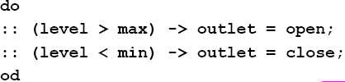
Repetition
The first statement sequence denotes the body of the loop
While the second denotes the termination condition Termination, however, is not always a desirable property of these system, in particular, when dealing with reactive systems

Slide 43
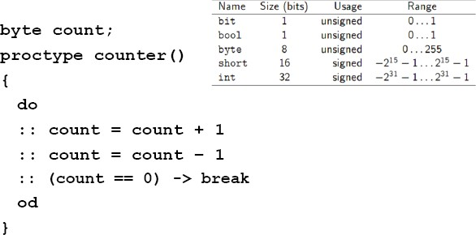
Repetition

Slide 44
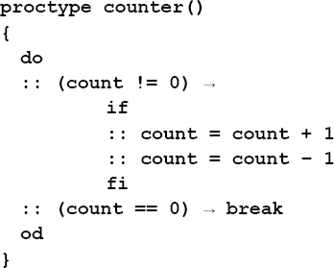
Combining Guards, Case, Repetition

Slide 45
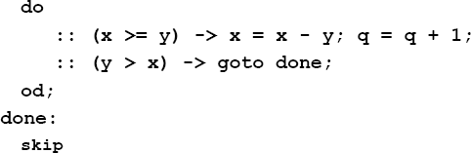
Unconditional Jump
PROMELA supports the notion of an unconditional jump via the “goto” statement
“done” denotes a label
A label can only appear after a statement A goto, like a skip, is always executable.

Slide 46
Assertions
An assertion is a statement which can be either true or false
Interleaving assertion evaluation with code execution provides
A simple yet very useful mechanism for checking desirable as well as erroneous behavior with respect to our models
Assertion: Syntax within PROMELA
assert( <logical-statement>)
E.g. assert(!(doors == open && lift == moving))
Within PROMELA we can express local assertions as well as global system assertions

Slide 47
Global Assertions
A global assertion is also known as a system invariant
Is a property that is true in the initial system state and remains true in all possible execution paths.
To express a system invariant within PROMELA
One must define a monitor process that contains the desired system invariant
To ensure that the global assertion is checked anypoint during the execution
An instance of the monitor process has to be run along with the rest of the system model
In the case of a simulation the checking is not exhaustive, this is achieved within verification mode

Slide 48
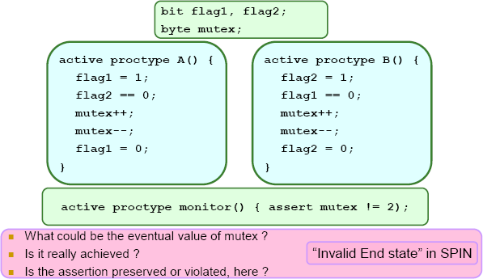
Mutual Exclusion #2

Slide 49
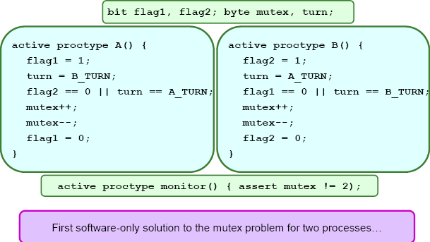
Mutual Exclusion #3 – Dekker’s Algorithm

Slide 50
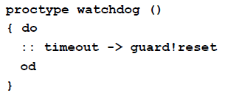
Timeouts
Reactive systems typically require a means of aborting OR rebooting when a system deadlocks.
PROMELA provides a primitive statement called timeout for the purpose.
The timeout condition becomes true when no other statements within the overall system being modeled are executable

Slide 51
Exceptions
The unless statement
A useful exception handling feature
{statements-1} unless {statements-2} Consider an alternate watchdog process.

Slide 52
Message Channels
Means to achieve communication between distinct processes?
PROMELA supports message channels:
Provide a more natural and sophisticated means of
modelling inter-process communication/data transfer
Channel declaration:
chan <name> = <dim> of {<t1>,<t2>,<t3> … <tn>}
E.g. chan q = [1] of {byte} ; chan q = [3] of {mtype, int}
If dim = 0 then synchronous. E.g. chan q = [0] of {bit}
A channel can be defined to be either local or global

Slide 53
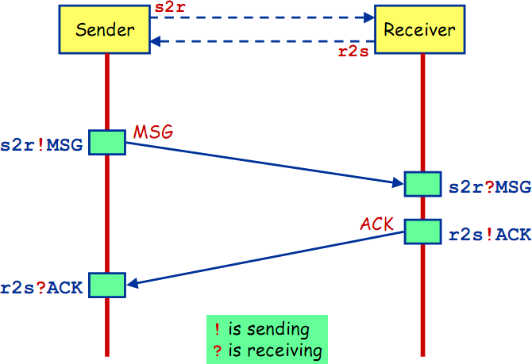
Message Channels

Slide 54
Message Channels… Sending-in
Sending messages through a channel – FIFO buffer (dim>0)
Achieved by ! Operator
E.g. in_data ! 4
Type of the channel and variable must match.
If multiple data values are to be transferred via each message
out_data ! x+1, true, in_data
The executability of a send statement is dependent upon the associated channel being non-full

Slide 55
Message Channels… Receiving from
Receiving messages is achieved by ? Operator
E.g. in_data ? Msg
If the channel is not empty, the first message is fetched from the channel and is stored in msg
Multiple values can also be fetched.
E.g. out_data ? value1, value2, value 3;
The executability of a receive statement is dependent upon the associated channel being non-empty,

Slide 56
Message Channels…
If more data values are sent per message than can be stored by a channel then the extra data values are lost
E.g. in_data ! msg1, msg2 ; msg2 will be lost
If fewer data values are sent per message than are expected, then the missing data values are undefined.
E.g. out_data ! 4, true and out_data? x, y , z
x and y will be assigned the values 4 and true respectively while the value of z will be undefined.

Slide 57
Message Channels…
len operator
To determine the number of messages in a channel
E.g. len (in_data)
If the channel is empty then the statement will block.
empty, full operators
Determine whether or not messages can be received or sent respectively.
E.g. empty(in_data) ; full (in_data)
Non-destructive retrieve
out_data ? [x, y, z]
Returns 1 if out_data ? x,y,z is executable otherwise 0.
No side-effects. Only evaluation, not execution. No message retrieved.

Slide 58
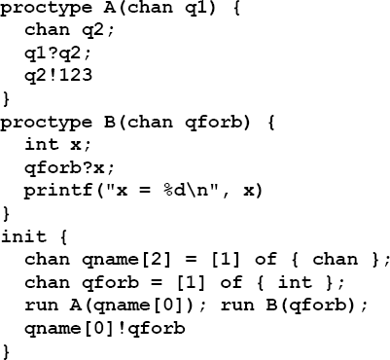
Channels as parameters
Output?

Slide 59
Communication type
What was the type of communication pattern observed in the examples till now?
Synchronous OR Asynchronous ? Why?

Slide 60
Synchronous Communication
When the channel declaration is
chan ch = [0] of {bit, byte}; i.e. when dim = 0
If ch ! x is enabled and
If there is a corresponding receive ch ? X
that can be executed simultaneously and both the statements are enabled
Both statements will handshake and together do the transition
chan ch = [0] of {bit, byte}
P wants to perform ch ! 1, 3 + 7 Q wants to perform ch ? 1, x
Then after communication x will be 10.

Slide 61
Alternating Bit Protocol
To every message, the sender adds a bit
The receiver acknowledges each message by sending the received bit back.
The receiver only expects messages with a bit that is expected to receive
If the sender is sure that the receiver has correctly received the previous message, it sends a new message and it alternates the accompanying bit

